Slide 1
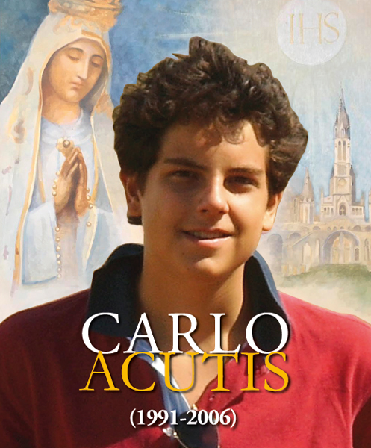
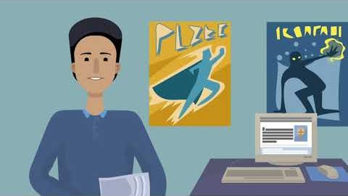
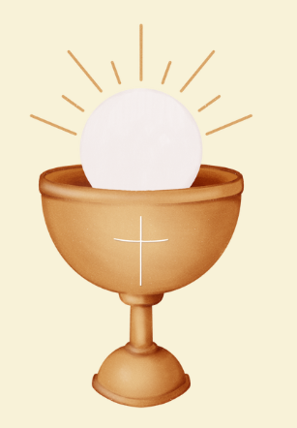
‘To always be close to Jesus, that is my life plan.’
Saint Carlo Acutis 1991-2006

Slide 2
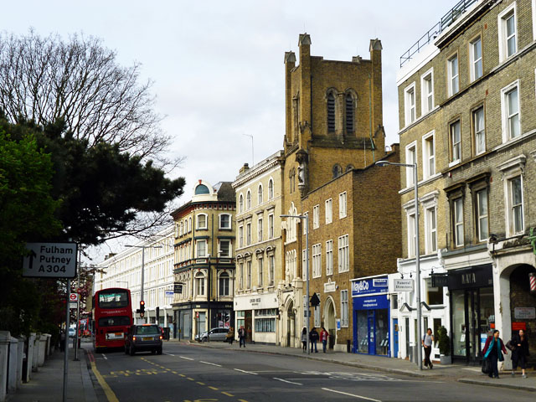
Carlo Acutis was born on 3rd May 1991, in Fulham, London and was baptised on the 18th May. When he was two months old the family moved back to Milan in Italy.

Slide 3
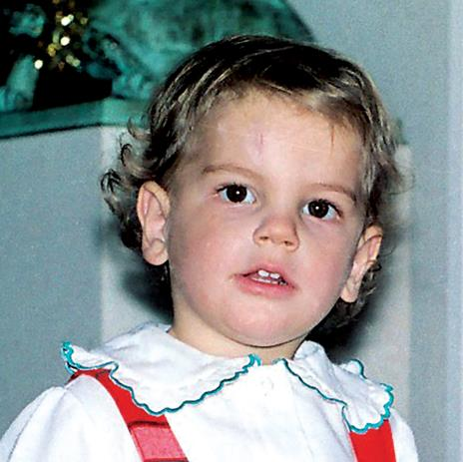
From a young age, Carlo had a special love for God. He could not walk past a Church without going in. He liked putting flowers in front of statues of Mary.

Slide 4
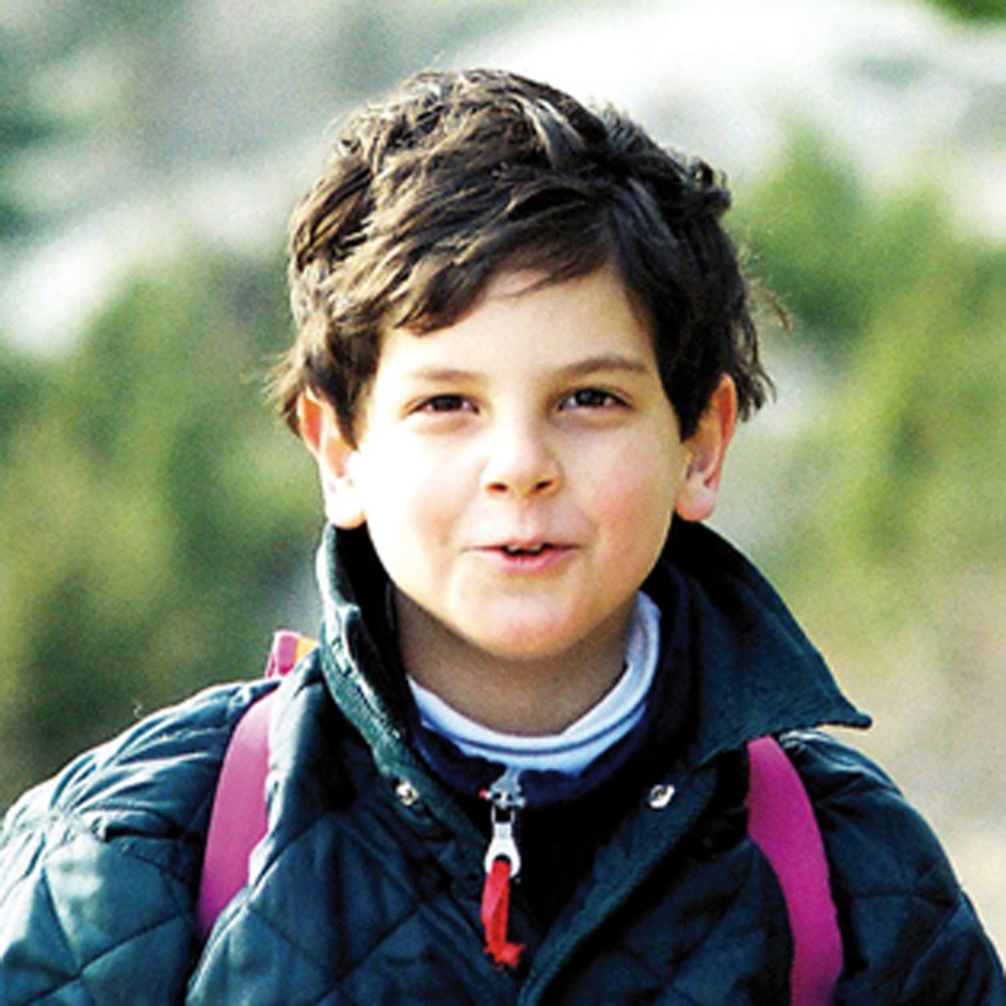
Even when he was little, Carlo loved to pray the Rosary. After he made his First Holy Communion, he went to Mass as often as he could and spent time praying in front of the Blessed Sacrament. He said, ‘The more Eucharist we receive the more we will become like Jesus.’

Slide 5
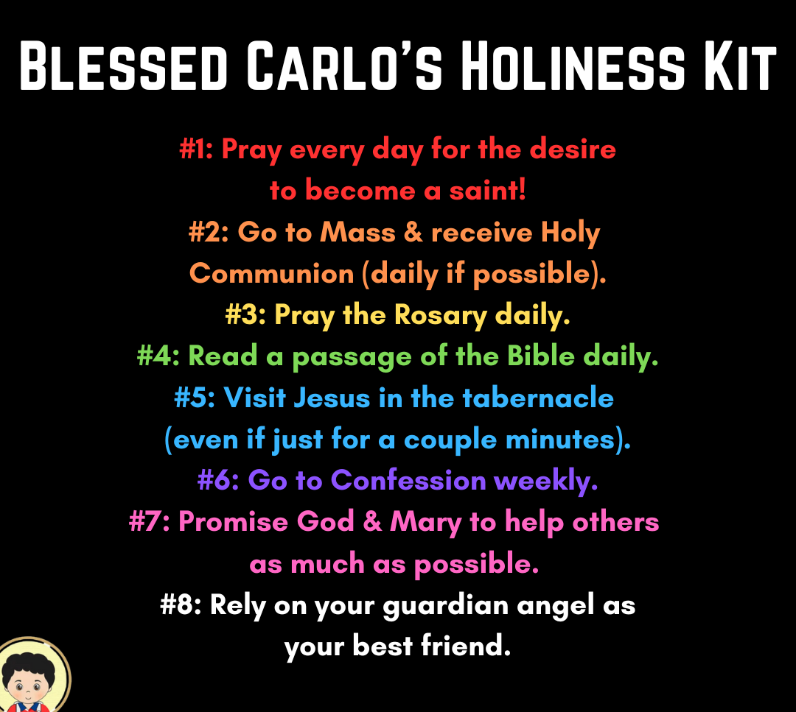
When he was eleven years old, he received the Sacrament of Confirmation and began helping to teach younger children. He made a holiness kit for them.

Slide 6

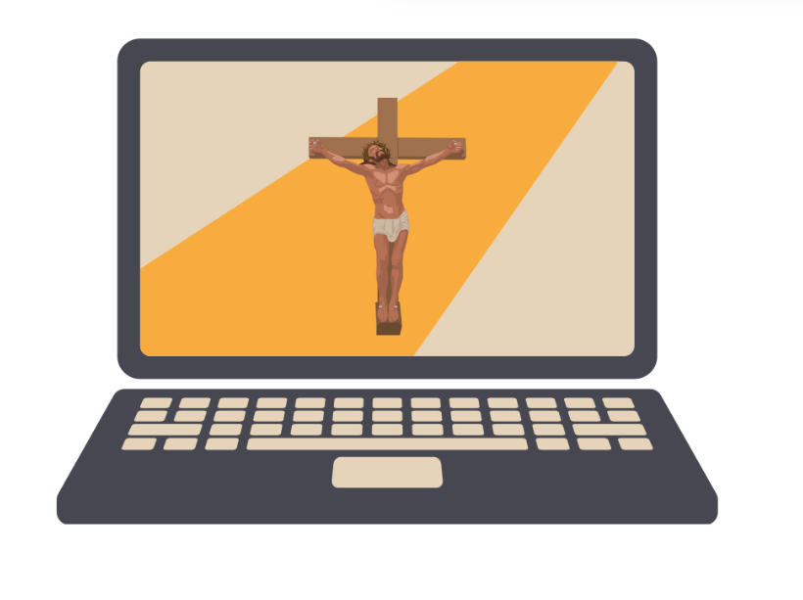
Carlo loved playing video games. He had a PS2. Although he loved to game, Carlo only allowed himself to play for an hour a week. He made a website to record Eucharistic miracles He taught himself to code using a university computer science textbook and then learned how to edit videos and create animation. Carlo used the internet in service of the Gospel and to share his faith. He was a light of Jesus.

Slide 7
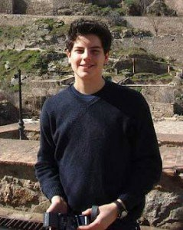
Carlo asked his parents to take him on pilgrimages — to the places of the saints, and to the sites of Eucharistic miracles.

Slide 8
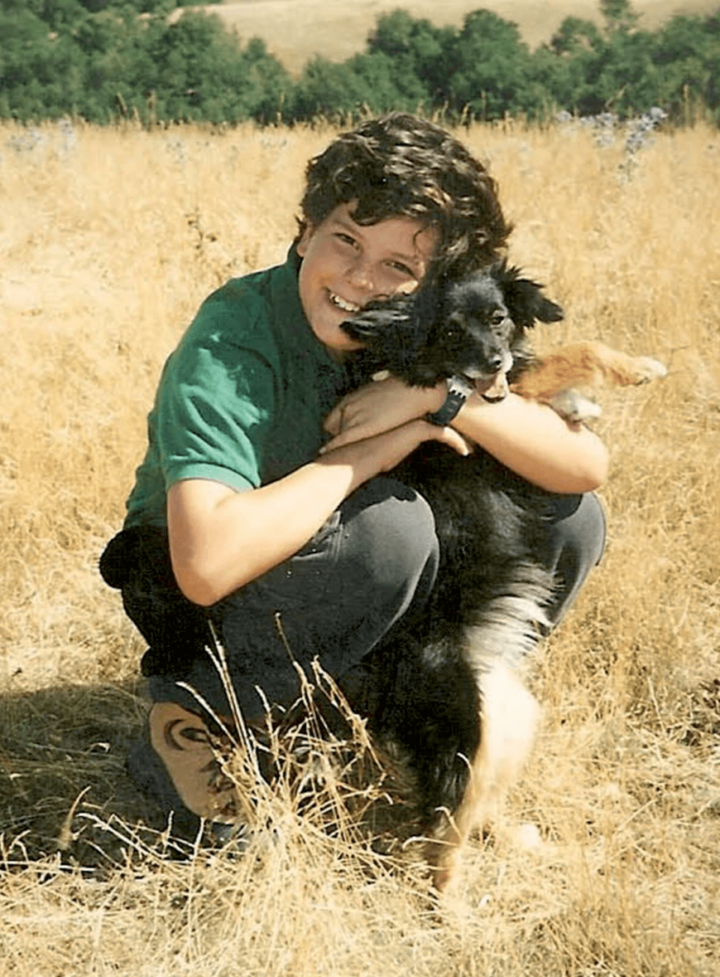
Carlo was a boy who loved football, video games, telling jokes and his friends. He had a few pets; four dogs, two cats and lots of goldfish. He played the saxophone and enjoyed eating sweets.

Slide 9
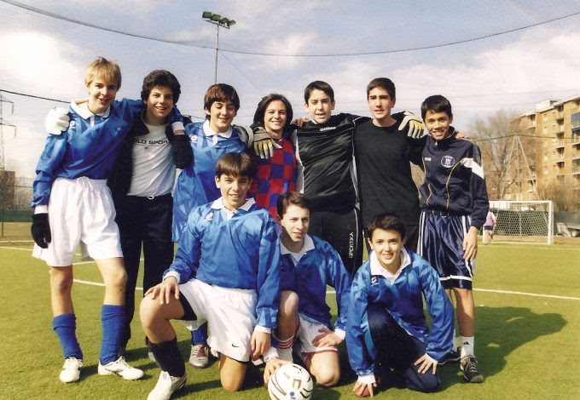
Carlo looked after children at school who were picked on, particularly children with special needs. He was a good leader, but his leadership was in service of others.

Slide 10
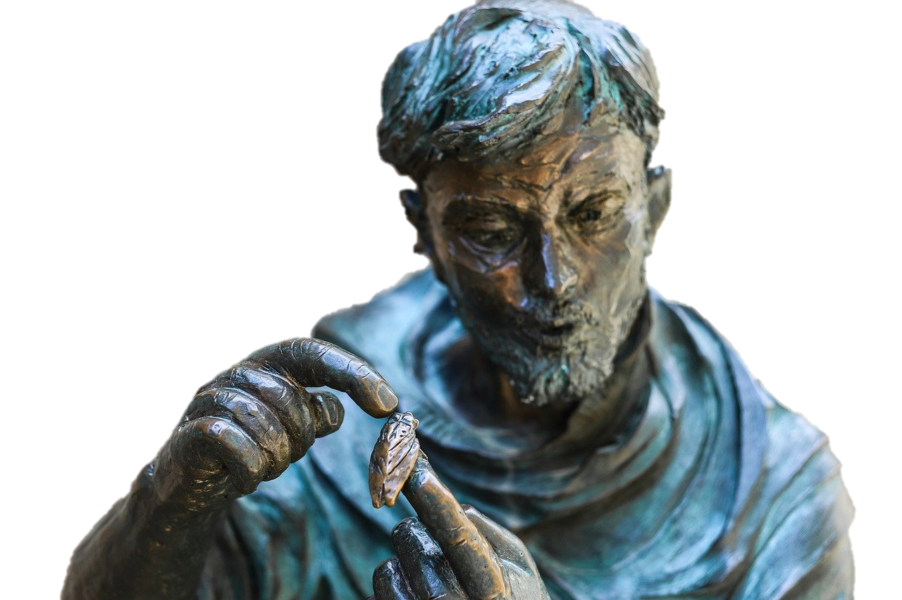
Carlo was tragically diagnosed with leukaemia. He died on 12th October 2006, and was buried in Assisi because of his love for St Francis of Assisi. Many people came to his funeral; some were poor and homeless because Carlo had given them food and sleeping bags.

Slide 11
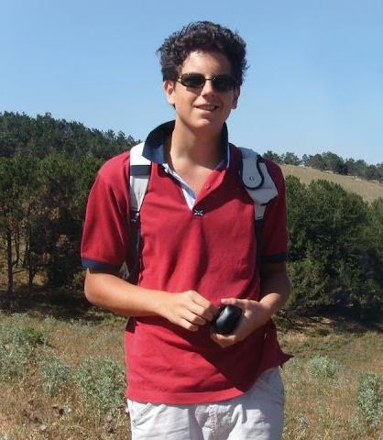
Carlo was put on the road to sainthood after Pope Francis approved two miracles. The first was the healing of a 7-year-old Brazilian boy after he had touched one of Carlo’s T-shirts. A twenty one year woman was healed after her parents prayed to Carlo after a bicycle accident that nearly killed her. Pope Leo will canonise Carlo on the 7th September 2005 in Rome.

Slide 12
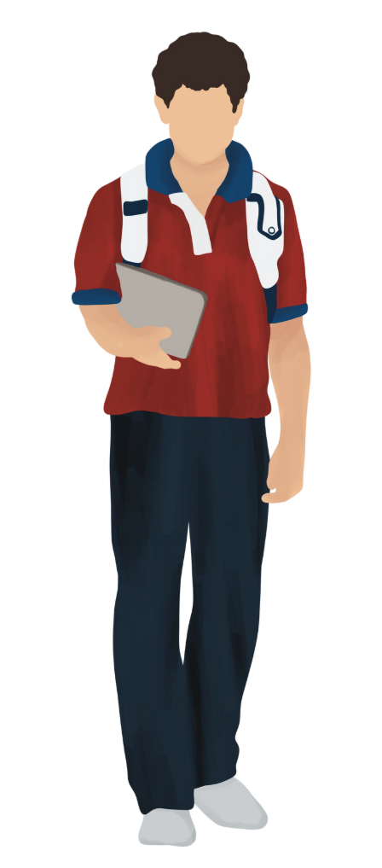
Heavenly Father, thank you for blessing Carlo Acutis with a holy life. Help us to follow his example of making you the centre of our lives. Help us to stay close to you, helping people in need and sharing our faith with others.
Amen.

Slide 13
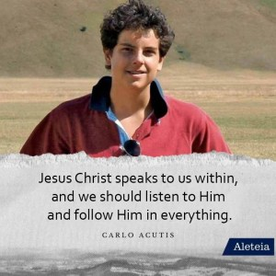

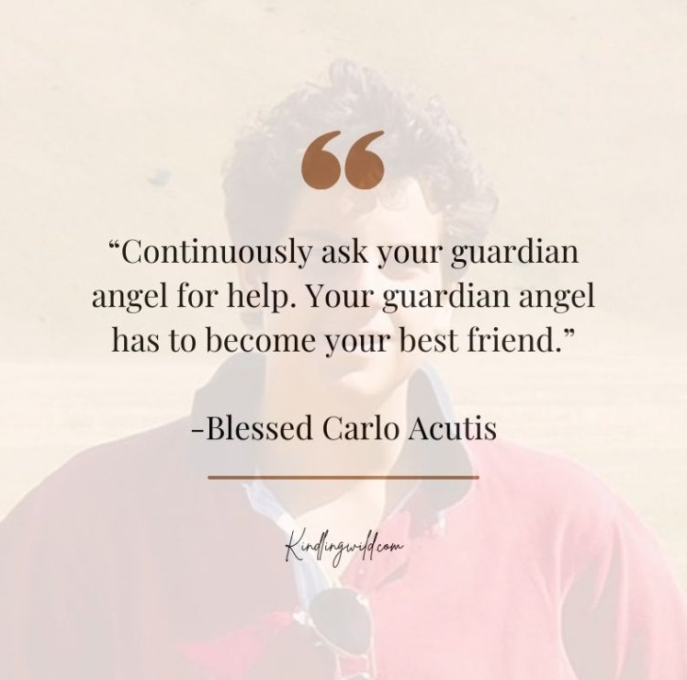
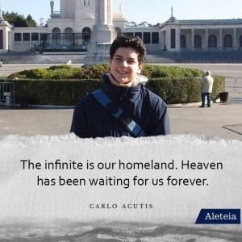
‘

Slide 14
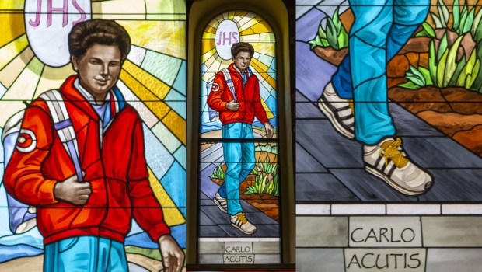
‘
Saint Carlo Acutis Feast Day 16th October

