Slide 1

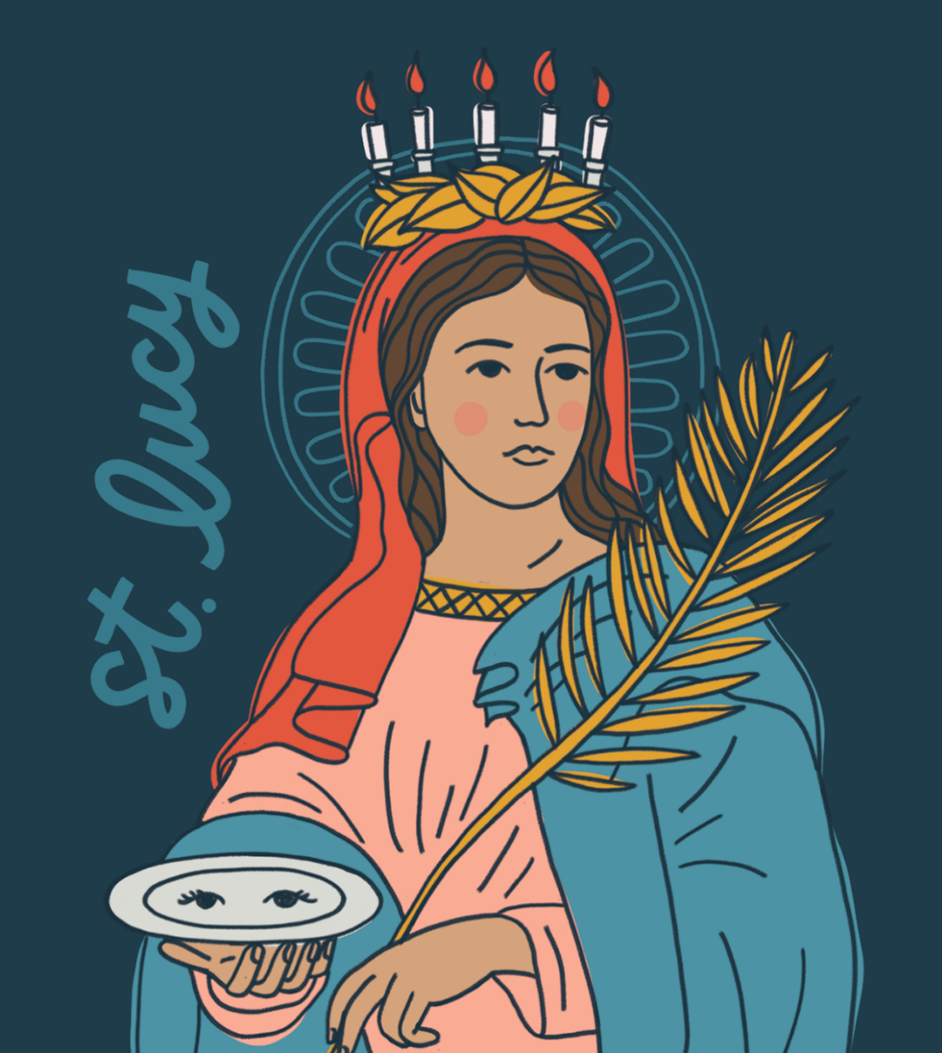
Saint Lucy
283-304 AD

Slide 2
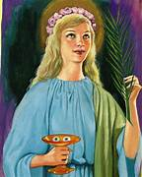
Saint Lucy was born in 280 into a rich family in Sicily, Italy. Her father died when she was five years old. Lucy’s mother told her about all the stories of Jesus and the first martyrs and so she decided to dedicate herself to Jesus.

Slide 3
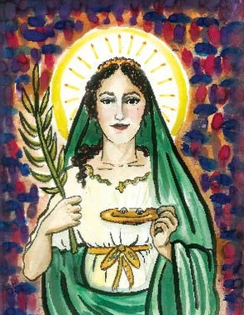
As Lucy had given herself to Jesus, she sold all her belongings and gave the money to the poor. People often came to her house and Lucy, and her mother gave food to everyone who asked and were a shining example of Christian Charity.

Slide 4
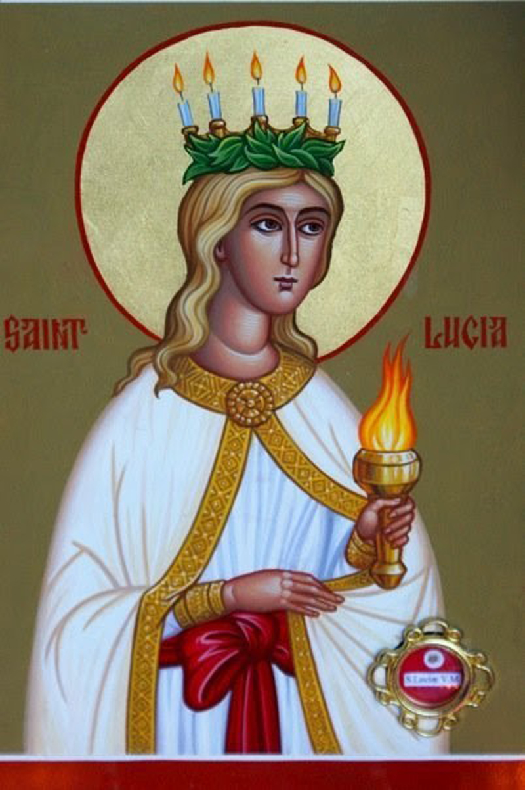
Lucy’s mother encouraged her to marry a man who did not believe in Christ. Lucy refused to marry him. The man was so angry with her that he informed the governor she was a Christian. Lucy told the governor she was prepared to give herself to God. She said, ‘I will never sin, so that the Holy Spirit will give me a greater reward.’

Slide 5
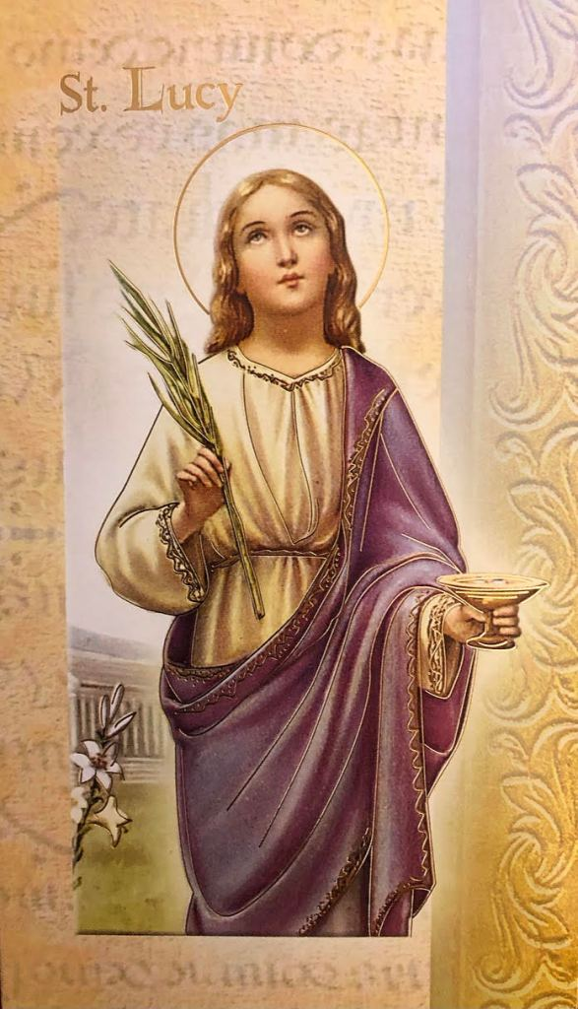
Lucy was led to the city for trial. The governor ordered a fire to be lit around her, but Lucy was not harmed. A soldier thrust a sword into her heart. Lucy was brave and faithful. She did not die until a priest came to her with Jesus in Holy Communion.

Slide 6
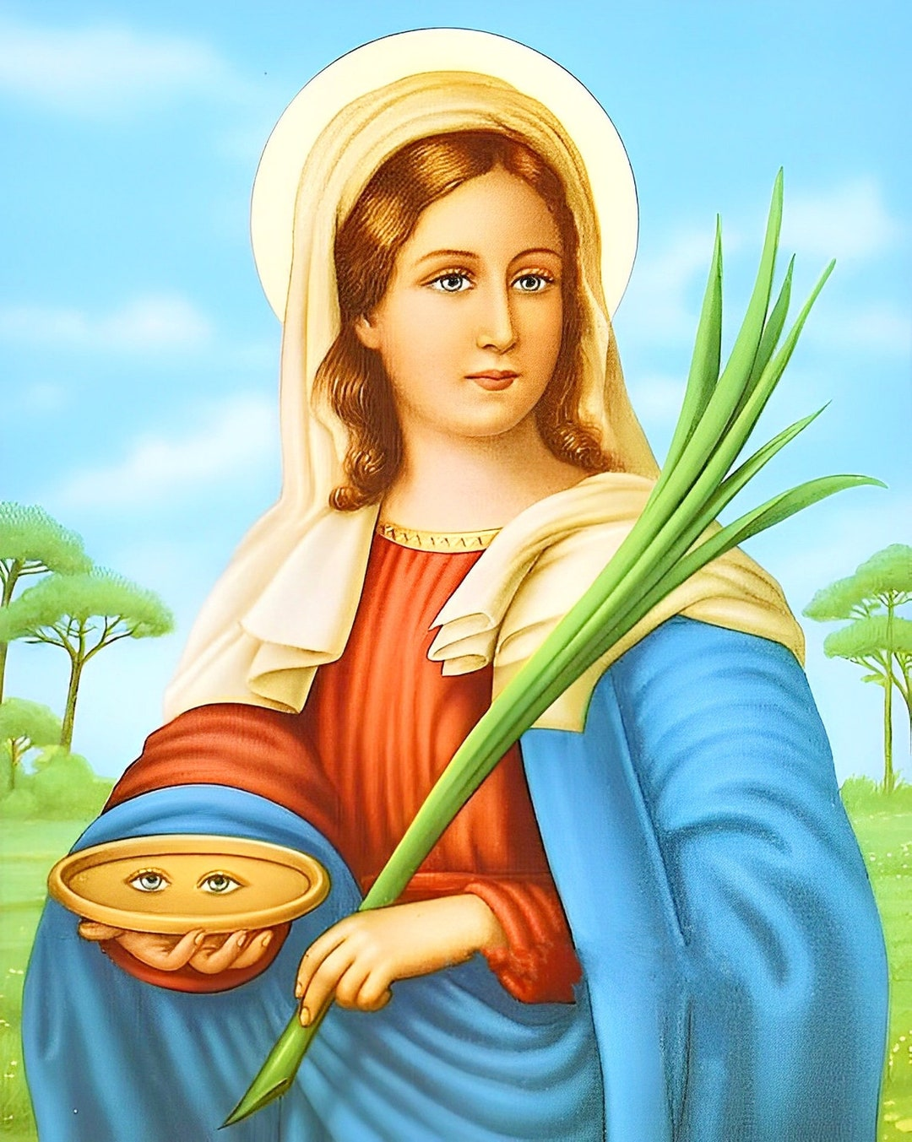
In one legend it said that Lucy’s eyes were torn out and later healed by God; this is why Saint Lucy is known as the Patron Saint for people who have trouble with their eyes.

Slide 7

No matter where we are we should bring the Light of Christ to all those around us. Each one of us has the light of our gifts and the Light of Christ shining in each one of us. Our light, as the gospel says is not meant to be hidden. We must share the light with others so that they will not remain in the darkness.

Slide 8
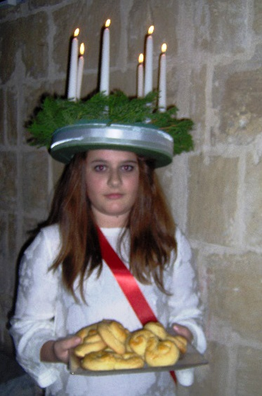
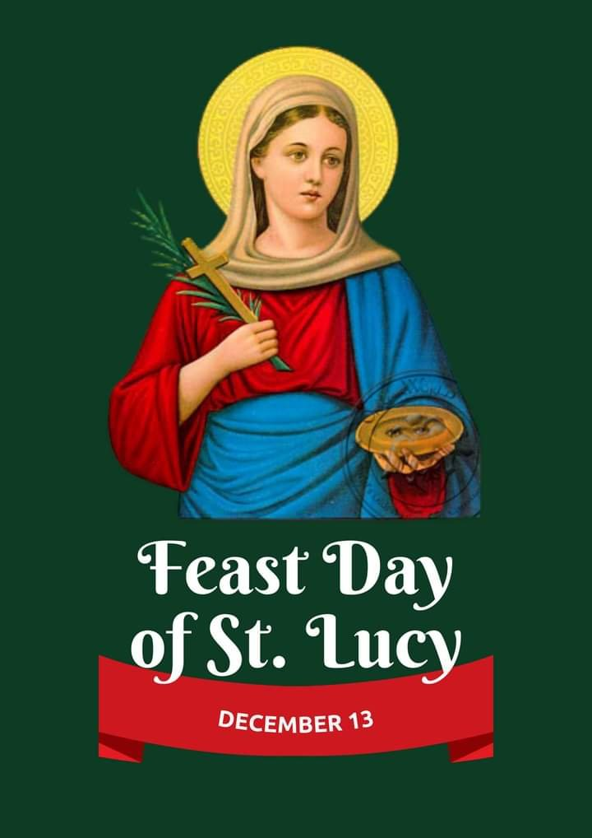
The Feast of St Lucy is often called the Festival of Light and is celebrated in a special way on the 13th of December. The oldest daughter in the family wears a white dress with a red sash. She has a crown of evergreen branches with seven lighted candles and serves her family with coffee and Lucy buns for breakfast as reminder that Jesus is the Bread of Life.
A Hungarian custom is to plant wheat in a small pot on Saint Lucy’s feast day. The wheat is then carried to the manger scene as a symbol of Christ.

Slide 9
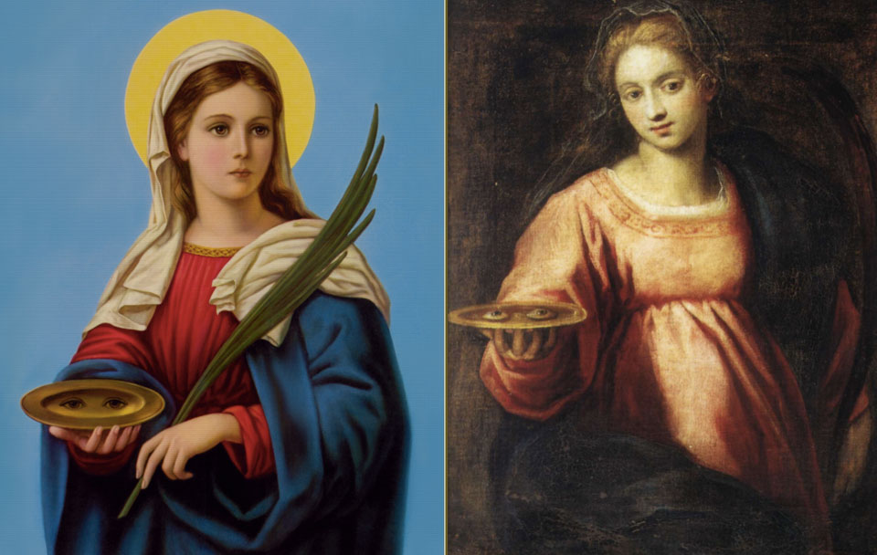
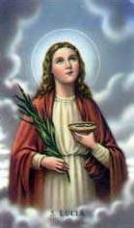
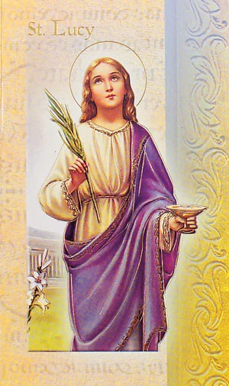
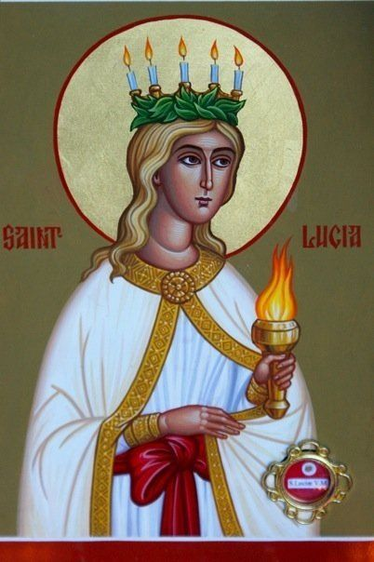
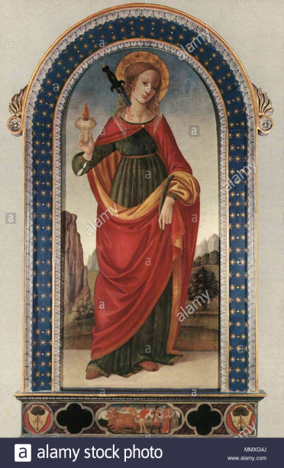
Saint Lucy, pray for us.

