Slide 1
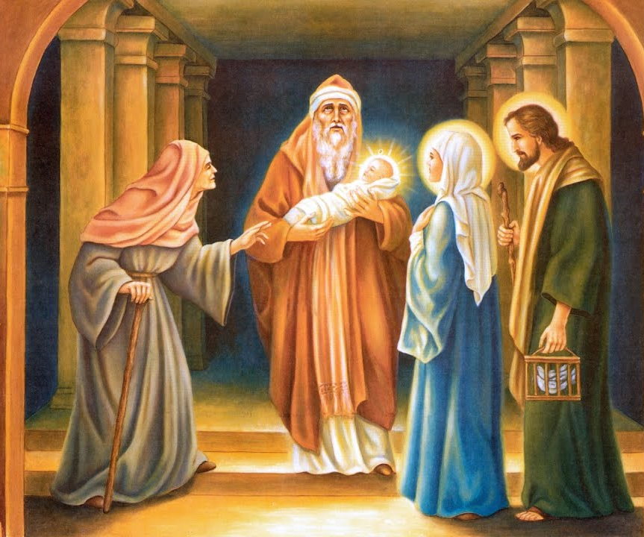
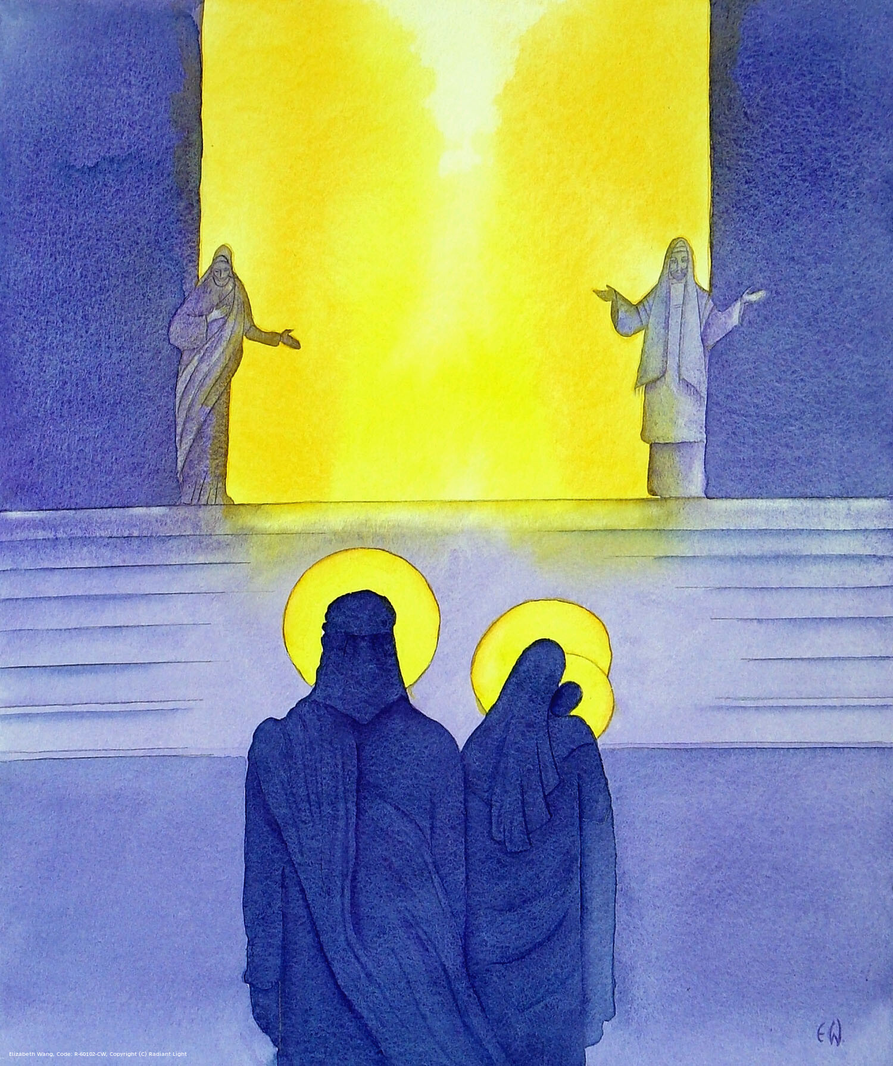
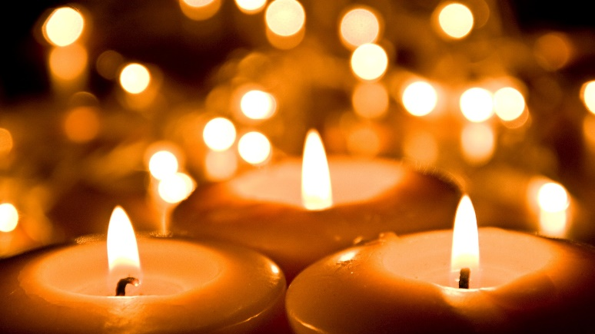
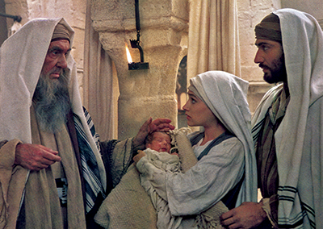
Year 5 GIFT Ambassadors Assembly
Presentation of Jesus in the Temple
Candlemass
10.02.25

Slide 2
Gathering Hymn
Lord, the light of Your love is shining
in the midst of the darkness shining;
Jesus, Light of the World, shine upon us,
Set us free by the truth you now bring us,
Shine on me, shine on me.
Shine, Jesus, shine, fill this land with the Father's glory;
Blaze Spirit, blaze, set our hearts on fire.
Flow, river, flow, flood the nations with grace and mercy;
Send forth Your word,
Lord, and let there be light.

Slide 3
Lord, I come to your awesome presence,
from the shadows into your radiance,
By the blood I may enter your brightness,
Search me, try me, consume all my darkness.
Shine on me, shine on me.
Shine, Jesus, shine, fill this land with the Father's glory;
Blaze Spirit, blaze, set our hearts on fire.
Flow, river, flow, flood the nations with grace and mercy;
Send forth Your word,
Lord, and let there be light.

Slide 4
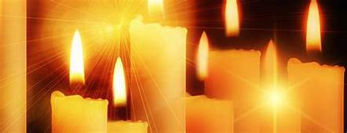

Prayers of Light
The Response is:
Shine in our hearts Lord.

Slide 5
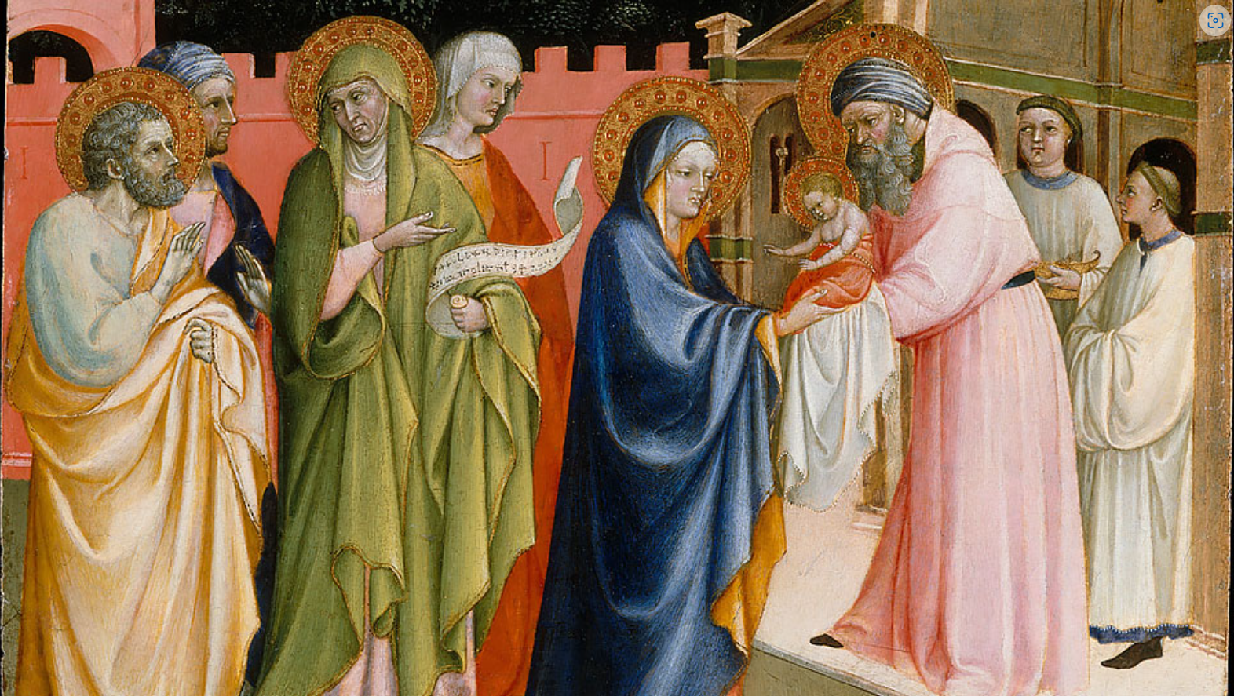


Slide 6
Gospel Acclamation
Allelu, allelu, allelu, alleluia praise ye the Lord.
Allelu, allelu, allelu, alleluia, praise ye the Lord.
Praise ye the Lord, alleluia, praise ye the Lord, alleluia.
Praise ye the Lord, alleluia, praise ye the Lord.
I am the Light of the World,
the light to give glory to your people.
I will show you the way into heaven says the Lord.

Slide 7
A reading from the holy Gospel according to Luke
When the day came for them to be purified Mary and Joseph took Jesus up to Jerusalem to present him to the Lord. Now in Jerusalem there was a man named Simeon. He was a good man who prayed to God every day. It had been revealed to him by the Holy Spirit that he would not see death until he had set eyes on Jesus. When Simeon saw Mary and Joseph, he took Jesus into his arms and blessed God and said, He is the light of the world.

Slide 8
Lord, I am your servant, and now I can die in peace, because you have kept your promise to me.
Simeon blessed them both, then he said to Mary,
Your heart will feel like its been pierced by a sword.
There was also a prophet, Anna, who never left the temple but worshipped night and day, fasting and praying.
She came over to Simeon and Mary and Joseph. Anna said,
I have seen Jesus and held the baby in her arms. Joseph and Mary left the temple with Jesus and returned to Galilee to their own town of Nazareth.
The Gospel of the Lord.
Praise to you Lord Jesus Christ.

Slide 9
This little guiding light of mine
I’m going to let it shine.
This little guiding light of mine
I’m going to let it shine.
This little guiding light of mine
I’m going to let it shine.
Let it shine, let it shine, let it shine.

Slide 10
Take my little light round the world
I’m going to let it shine.
Take my little light round the world
I’m going to let it shine.
Take my little light round the world
I’m going to let it shine.
Let it shine, let it shine, let it shine.

Slide 11
Don’t you (phew) my little light out,
I’m going to let it shine.
Don’t you (phew) my little light out,
I’m going to let it shine.
Don’t you (phew) my little light out,
I’m going to let it shine.
Let it shine, let it shine, let it shine.

Slide 12
Hide it under a bush, Oh No,
I’m going to let it shine.
Hide it under a bush, Oh No,
I’m going to let it shine.
Hide it under a bush, Oh No,
I’m going to let it shine.
Let it shine, let it shine, let it shine.

Slide 13
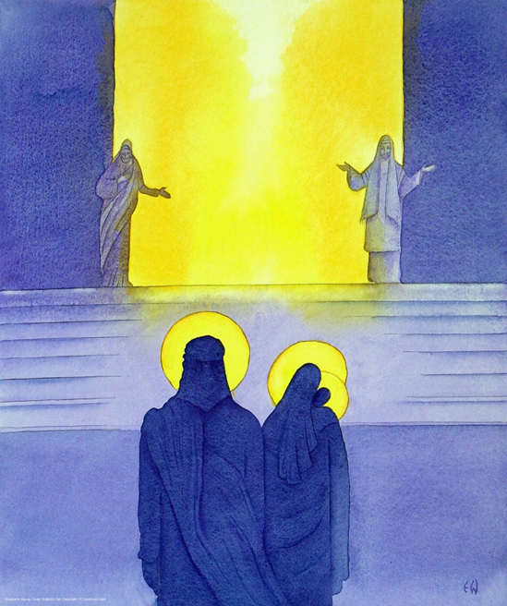

Slide 14
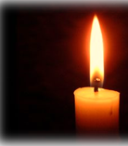
We pray for Pope Francis and Archbishop Bernard who show us the way to being good in this Jubilee Year. Help us to be kind and caring.
Jesus Light of the World, pray for us.

Slide 15
We pray for ourselves that we may follow the example of Simeon and Anna by praying every night and sharing the Word of Jesus.
Jesus Light of the World, pray for us.

Slide 16
We pray for the children in Year 3 and Year 6 that the preparation for their Holy Communion and Confirmation will make it a very holy occasion. May Jesus shine his loving light upon them as they take a step further on their faith journey.
Jesus Light of the World, pray for us.

Slide 17
We pray for people who are ill at the moment that God will shine his healing light upon them and give them courage in their suffering.
Jesus Light of the World, pray for us.

Slide 18
We pray for people who are having a hard time in Ukraine and Gaza that the wars will end soon and the hostages released so everyone will be safe.
Jesus Light of the World, pray for us.

Slide 19
Gracious God, the source and creator of light, who revealed to the aged Simeon the Light which enlightens the whole word, dispel the darkness of our souls and brighten the path that lies before us, may we come at the last to stand in your eternal light; through him, who is the light of the world and the glory of your people Israel, your Son Jesus Christ our Lord.
Amen.

Slide 20
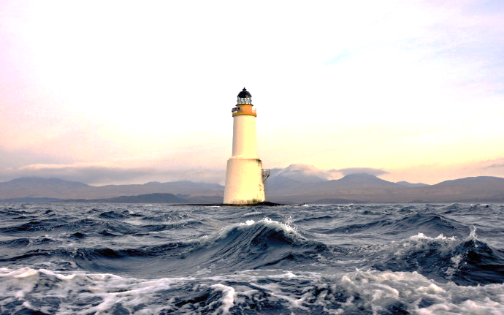
In my wrestling and in my doubts
In my failures You won't walk out
Your great love will lead me through
You are the peace in my troubled sea,
You are the peace in my troubled sea.
In the silence, You won't let go
In the questions, your truth will hold
Your great love will lead me through
You are the peace in my troubled sea,
You are the peace in my troubled sea.

Slide 21
My Lighthouse, my lighthouse
Shining in the darkness, I will follow You
My Lighthouse, my Lighthouse
I will trust the promise, you will carry me safe to shore
Safe to shore, safe to shore, safe to shore.
I won't fear what tomorrow brings
With each morning I'll rise and sing
My God's love will lead me through
You are the peace in my troubled sea.
You are the peace in my troubled sea.

Slide 22
My Lighthouse, my lighthouse
Shining in the darkness, I will follow You
My Lighthouse, my Lighthouse
I will trust the promise,
You will carry me safe to shore
Safe to shore, safe to shore, safe to shore.

Slide 23

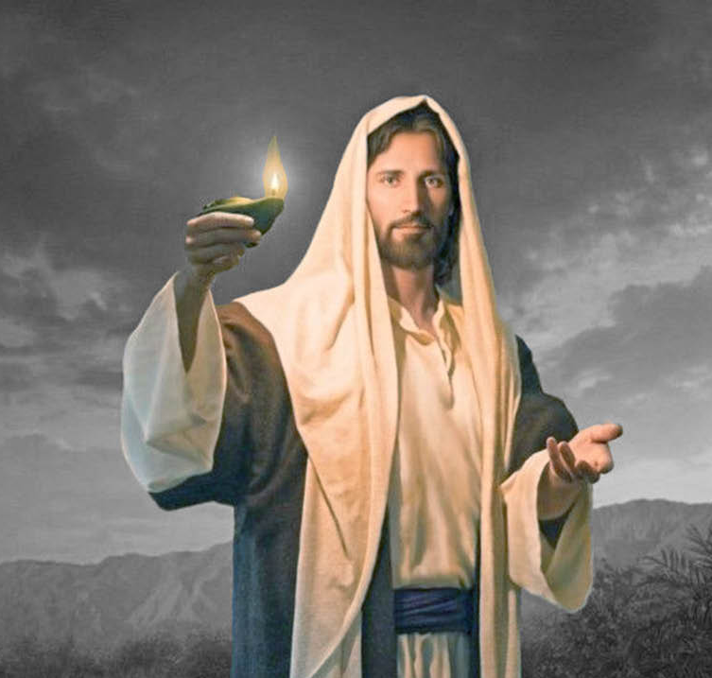

Share the light of Jesus
with everyone around us

